Slide 1
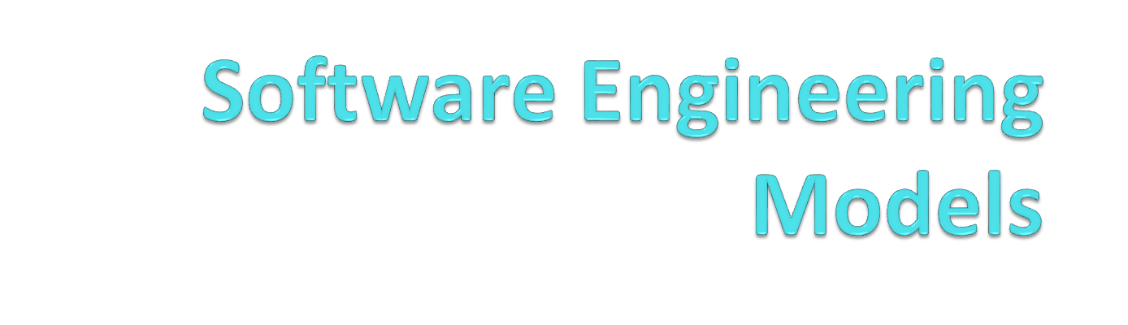
Module -2

Slide 2
Software Process
A software process (also knows as software methodology) is a set of related activities that leads to the production of the software.
These activities may involve the development of the software from the scratch, or, modifying an existing system.

Slide 3
A process also includes the process description, which includes:
Products: The outcomes of the an activity. For example, the outcome of architectural design maybe a model for the software architecture.
Roles: The responsibilities of the people involved in the process. For example, the project manager, programmer, etc.
Pre and post conditions: The conditions that must be true before and after an activity. For example, the pre condition of the architectural design is the requirements have been approved by the customer, while the post condition is the diagrams describing the architectural have been reviewed.

Slide 4
Any software process must include the following four activities:
Software specification (or requirements engineering): Define the main functionalities of the software and the constraints around them.
Software design and implementation: The software is to be designed and programmed.
Software verification and validation: The software must conforms to it’s specification and meets the customer needs.
Software evolution (software maintenance): The software is being modified to meet customer and market requirements changes.

Slide 5
Supporting Activities
Configuration and change management,
quality assurance,
project management,
user experience.

Slide 6
Software Process Models /Software Engineering models
Description of the sequence of activities carried out in an SE project
describes the sequence of phases for the entire lifetime of a product.
also called Product Life Cycle.
This covers everything from the initial commercial idea until the final de-installation or disassembling of the product after its use.

Slide 7
MODEL APPROACHES
There are a lot of different development models.
Agile methods-
allow a project’s goal to change over time to track changing customer needs.
Test‐driven development
forces programmers to write tests for their code.
Extreme programming
uses “pair programming” to ensure that every piece of code goes through a kind of code review.
Each model has its own set of rules, philosophy and list of important principles.

Slide 8
PREREQUISITES
Before you start using a particular model, need to be sure everyone on the team is on board.
Everyone needs to agree on what the rules are and what procedures you will use to make sure the rules are followed.

Slide 9
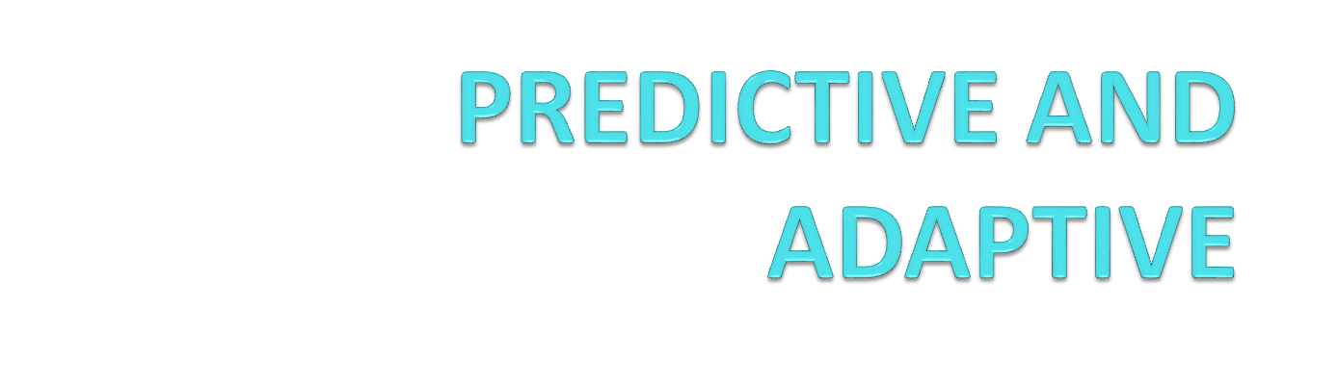

Slide 10
PREDICTIVE DEVELOPMENT MODEL
Predict in advance what needs to be done
Based on past experience, it is easy to predict the time, cost etc.
It’s often hard to predict exactly what a software application needs to do and also the duration.
Sometimes, may not be familiar with the new programming tool.
In changing business situations ,customer’s needs also changes as time goes.

Slide 11
ADAPTIVE DEVELOPMENT MODEL
Enables you to change the project’s goals if necessary during the development.
Periodically reevaluate and decide whether need to change the direction.
Eg: detective film. It starts with a murder.(Your goal is to find the killer.) but you don’t know exactly where the case will lead.
You follow the first clue, and it leads to a second, which leads to a third, and so forth. Each time you find a new clue, you update the direction of the investigation.

Slide 12
Which model is better?
We might think an adaptive model is always better than a predictive one, but there are cases in which a predictive model works quite well.
Predictive models work well when the project is relatively small; you know exactly what you need to do, and the timescale is short enough that the requirements won’t change during development.

Slide 13
Success And Failure Indicators
Success indicators
User involvement
If the users help define the requirements, they’re more likely to be correct.
Clear vision
If the customers and developers have the same clear vision about the project’s goals, development will stay on track.
Limited size
A small size helps the customers and team members see the whole picture all at once. Requirements won’t have time to change.
Experienced team
Experienced team members are less likely to design something they can’t build.
Realistic
Established technology
If you stick to technology that you’ve used before, you’ll understand how to use it correctly.

Slide 14
Failure indicators
Incomplete requirements
If the requirements don’t say you should do something, it won’t get done.
Unclear requirements
If the customers and developers don’t all have the same vision of what the application should do, you’ll have trouble satisfying everyone.
Changing requirements
The requirements are like railroad tracks: After they’re set, changing course is difficult.
No resources
Even if you have clear requirements and a perfect design, a single programmer can’t write a 10,000‐line program in a week.

Slide 15
Advantages of predictive model
Predictability
Stability
Cost-savings
Detailed design
Less refactoring
Fix bugs early
Better documentation
Easy maintenance

Slide 16
Disadvantages of predictive model
Inflexible
Later initial release
Big Design Up Front(BDUF)- you can’t start cranking out code until the requirements and designs are finished. For that reason, these models are sometimes called Big Design Up Front ( BDUF ) models.

Slide 17



The Waterfall Model
Notes:
*
07/16/96
*
##

Slide 18
WATERFALL MODEL
Requirements
Design
implementation
verification
Deployment
Maintenance

Slide 19
WATERFALL MODEL
Predictive model
Finish each step completely and thoroughly before move on to the next step.
In the waterfall model, each step follows the one before in a strict order
The water represents information and the stages act like buckets. When one bucket is full (you’ve finished filling it up with information), the information floods from that bucket into the next so that it can direct the following task.

Slide 20
A classic life cycle model / Linear sequential model proposed by Mr. Royce
When requirements are well understood and risk is low
Work flow is in a linear (i.e., sequential) fashion
A goal is achieved at the end of each phase

Slide 21
The model can work reasonable well if all the following assumptions are satisfied:
The requirements are precisely known in advance
The requirements include no unresolved high risk items
The requirements won’t change much during development
The team has previous experience with similar projects so that they know what is involved in building the application.
There is enough time to do everything sequentially.

Slide 22
You can add additional steps or split steps to give more details if you like.
You can also elaborate on a step .
e.g: break design into user interface design, high level design, low level design etc

Slide 23
WATERFALL MODEL WITH FEEDBACK
Enables the developer to move backward from one step to the previous step.
If you are working on design and discover that there was a problem in the requirements ,you can briefly go back to the requirements and fix them.
The farther you have to go back up the cascade , the harder it is. For example, if you’re working on implementation and discover a problem in the requirements, it’s hard to skip back up two steps to fix the problem.
Its also less meaningful to move back up the cascade for the later steps.

Slide 24
WATERFALL MODEL with feedback
Requirements
Design
implementation
/verification
Deployment
Maintenance

Slide 25
SASHMI
Also called sashmi waterfall or waterfall with overlapping phase.
Is similar to the waterfall except the steps are allowed to overlap.

Slide 26
SASHMI
requirements
design
implementation
verification
deployment
maintenance

Slide 27
SASHMI
In a project’s first phase some requirements will be defined while you are still working on others.
E.g:some of the team members can start designing the defined features while others continue working on the remaining requirements.
You can allow greater overlap between project phases.
For e.g: you could have people working on requirements,design,implementation and testing all at the same time.

Slide 28
SASHMI(advantages)
People with different skills can focus on their specialities without waiting for others.
It lets you perform a spike or deep dive into a particular topic to learn more about it.
It lets later phases modify earlier phases.

Slide 29
Incremental waterfall
Or multi waterfall model
Uses a series of separate waterfall cascades.
Each cascade ends with the delivery of a usable application called an increment.
Each increment includes more features than the previous one.
Building the final application incrementally.

Slide 30
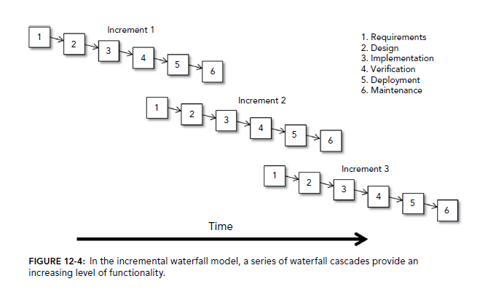
Incremental waterfall

Slide 31
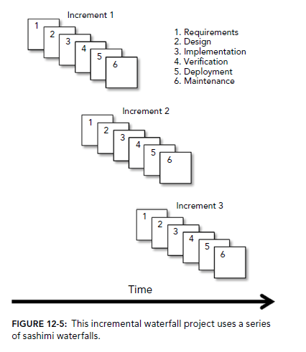

Slide 32
Incremental waterfall
It is somewhat adaptive model because its lets you to reevaluate the direction at the start of each increment
But it lets you to change the direction only in the beginning of new increment.
Within each increment it run predictively.
You can make only small changes allowed by whichever particular waterfall model you use for the increments (waterfall with feedback or sashimi).

Slide 33
V-MODEL
Basically a waterfall model that’s been bent into a V shape.
time
Concept< --------------------------
Operation & maintenance
Requirements ←----------verification &validation
Design ←---testing
decomposition
implementation
integration

Slide 34
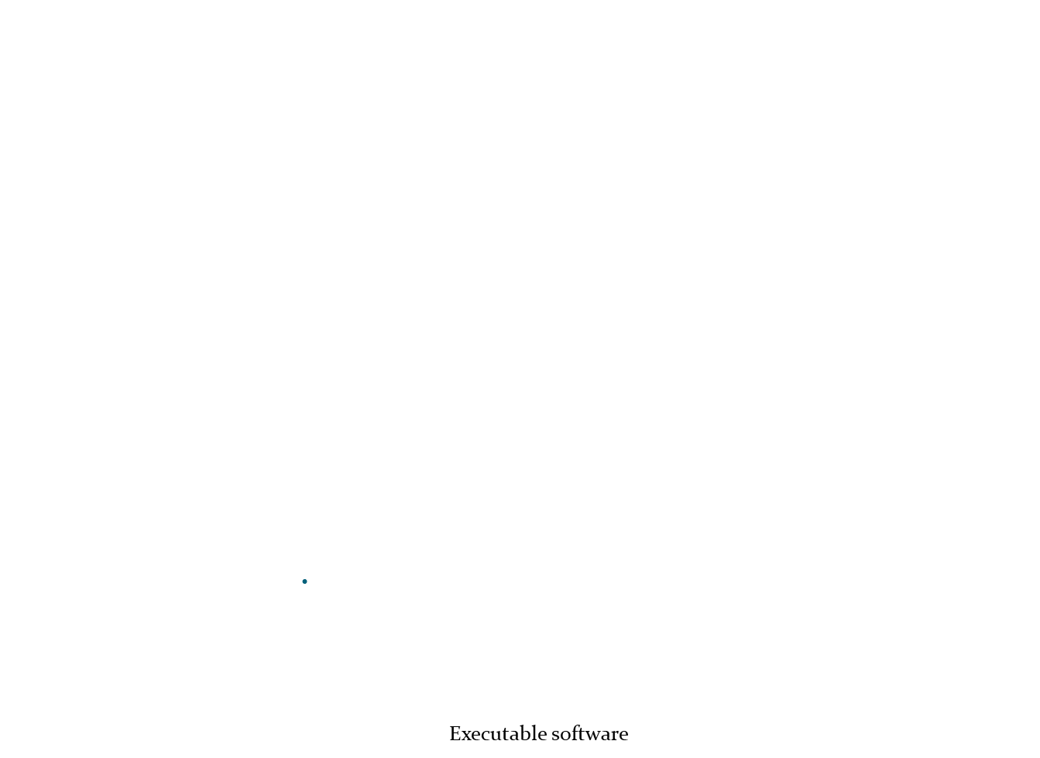
Requirement modeling
Acceptance testing
Architectural design
System testing
Component design
Integration testing
Code generation
Unit testing

Slide 35
V-MODEL
The task on the left side of the V break the application down from its highest conceptual level into more and more detailed task.
The process of breaking the application down into pieces is called decomposition.

Slide 36
V-MODEL
The tasks on the right side of the V consider the finished application at greater and greater levels of abstraction.
Testing verifies that the code works, and in the next level verification confirms that the application satisfies the requirements, and validation confirms that the application meets customer needs.
The process of working back up to the conceptual top of the application is called integration.

Slide 37
V-MODEL
Each of the tasks on the left corresponds to a task on the right with a similar level of abstraction.
At the highest level, the initial concept corresponds to operation and maintenance.
At the next level, the requirements correspond quite directly to verification and validation.
Testing confirms that the design worked.

Slide 38
Waterfall vs v-model
waterfall model, the testing activities are carried out after the development activities are over. On the other hand in V model, testing activities start with the first stage itself.
waterfall model is a continuous process, while the V model is a simultaneous process.
As compared to a software made using waterfall model, the number of defects in the software made using V model are less.

Slide 39
making changes in the software in waterfall model is a difficult task, and also proves to be a costly affair. The vice versa is true of the V model.

Slide 40
System development life cycle(SDLC)
Application development life cycle
It covers all the tasks that go into a software engineering project from start to finish-like waterfall model
The end of one project feed directly into the next project in a never ending cycle.
Incremental waterfall is a version of SDLC
You can break down the basic steps in a lot more detail if you like.

Slide 41
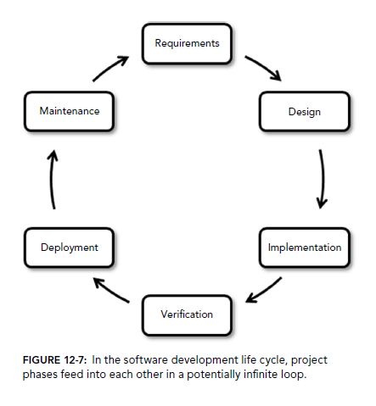

Slide 42
SDLC
Tasks involved in SDLC
1. Initiation
2. Concept development
Initial project definition , feasibility analysis(go/no go decision),preliminary planning, a cost‐benefit analysis, and a risk analysis.
3. Preliminary planning
PM and technical lead
Breaking into small units and team leaders are assigned
Leaders make preliminary planning to estimate necessary resources like computers, staffing, network, development tools etc
Leaders gather the tools they’ll need to track and manage the project
Building PERT and Gantt charts, and tracking tasks.
The technical managers also decide on the development model, programming language, development environment, coding tools.

Slide 43
4. Requirement analysis- studies the user’s needs and creates requirement documents, include UML diagrams
5. High level design- The team creates high‐level designs that specify major subsystems, data flow, database needs, and the rest of the application’s high‐level structure.
6. Low level design- how to build the application’s pieces.
7. Development- team writes the program code. They follow good programming practices, They perform unit tests, regression tests, and system tests.
8. Acceptance testing- customers get a chance to take the application for a test drive in its final form.
9. Deployment
10. Maintenance - whether it needs repair, enhancement, or replacement with a new version or with something completely different.
11. Review- team uses metrics to assess the project
12. Disposal- application’s removal and possibly its replacement by something else.

Slide 44
Predictive model-characteristics
They give a lot of structure to a project
Have a fully developed plan that can follow throughout the project’s life time.
Predictive project make scheduling simpler, includes documentation ,costless etc
But will not handle changes

Slide 45
ITERATIVE VERSUS PREDICTIVE
Problem with predictive model:
Not suited to handle unexpected changes
Can deal with small changes; don't handle big changes well
Spend a lot effort at the beginning, figuring out exactly what they will do.
Don’t handle fuzzy requirements well.
Iterative models address those problems by building the application incrementally.

Slide 46
ITERATIVE MODEL
Start by building the smallest program that is reasonably useful.
Then use a series of increments to add more features to the program until it is finished.
Each increment has relatively small duration.
It handles fuzzy requirements reasonably well.
Useful if we are unsure of some of the requirements.

Slide 47
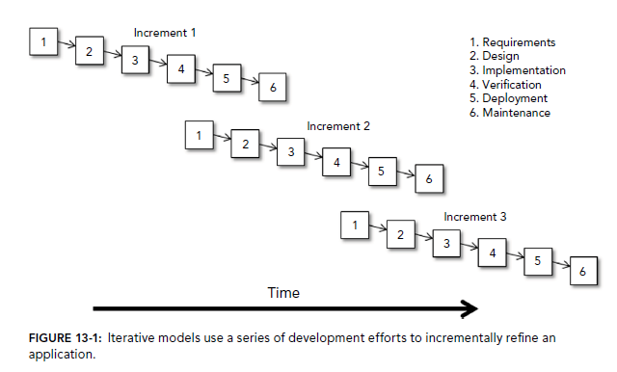

Slide 48
ITERATIVE VERSUS INCREMENTAL
suppose in version 1 of a project you produce a usable application, but its code doesn’t follow good programming standards.
In version 2 you rewrite the code to make the project more maintainable.
Version 2 doesn’t add any new features to the application, so in some sense you might not think of it as an incremental improvement over version 1.
The process is iterative but not incremental.

Slide 49
Prototypes
It can be useful in iterative development.
Prototype is a simplified model that demonstrates some behaviour of the project.
Prototype does not work exactly the same way the finished application will work
However it lets the customer see what the application will look like.
After the customers experiment with the prototype, they can give you feed back to help to refine the requirements.

Slide 50
Types of prototypes
Throwaway prototype
Evolutionary prototype
Incremental prototype

Slide 51
Throw-away Prototypes:
Here the prototype is used to test out some ideas or to make some unclear requirements clear.
The prototype is discarded once the requirements are clear and the development of the operational system is commenced
Prototype may be developed using an easy to use language and quality is of low importance
Evolutionary Prototypes:
The prototype is developed and modified until it is finally in a state where it can become the operational system.
Quality is very important in this approach and standards are followed
Prototype is developed in the same language & technology used for the final system

Slide 52
Incremental Prototype
We build a collection of prototypes of that separately demonstrate the finished application’s features. You then combine the prototypes (or at least their code) to build the finished application.

Slide 53
Advantages of Prototype
Improved requirements
Customers provide feedback to modify the requirements
Common vision
Common vision of what the application should do and what it should look like
Better design
Prototypes also let developers test different approaches to see which one is best.

Slide 54
Disadvantages of Prototype
Narrowing vision - When you show customers (and developers) a prototype, they’ll be less likely to think about other solutions that might do a better job.
Customer impatient - A good prototype can make customers think that the finished application is just around the corner.
Scheduled pressure – may pressure you to shorten the schedule.
Raised expectation - a prototype may demonstrate features that won’t be included in the application.
Attachment to code - developers become attached to the prototype’s code. That can make them follow the methods used by that code even if a better design exists.
Never-ending prototype - developers spend far too much time refining a prototypeto make it look better and include more features that aren’t actually necessary

Slide 55
SPIRAL Model
Was first described in 1986 by Barry Bohm.
This model uses a risk driven approach to help project teams decide on what development approach to take for various parts of the projects.

Slide 56
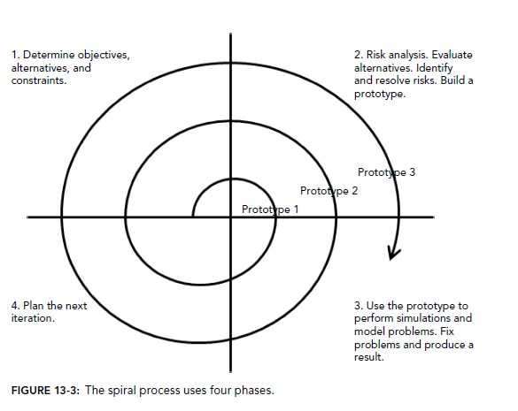

Slide 57
It combines the features of waterfall model and evolutionary prototyping model
It emphasizes on risk management activities
Spiral model is cyclic and consists of multiple cycles of 4 stages each. Each stage is represented as a quadrant of the cycle
Four stages are:
Determine objectives, alternatives and constraints
Evaluate alternatives, identify and resolve risks
Develop and verify next level product
Plan next cycle

Slide 58
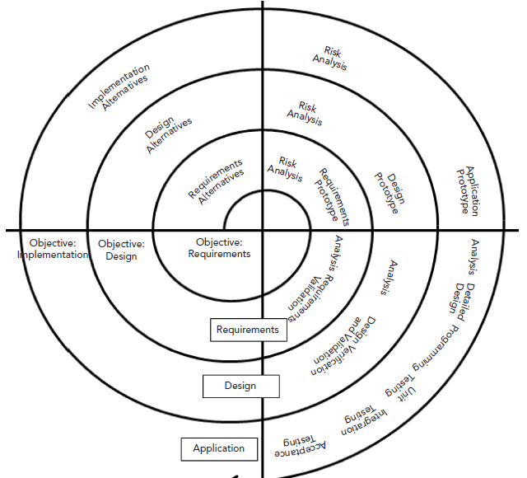

Slide 59
Four phases
In the first phase, determine the objectives of the current cycle.
In the second phase, perform a risk analysis to determine what the biggest risk factors are that could prevent you from achieving this cycles objectives.
Resolve the risk and build a prototype to achieve the objective.

Slide 60
In the third phase (engineering phase) use the prototype just built to evaluate your solution.
In the fourth phase (evaluation phase) you evaluate your progress so far and make sure the projects major stake holders agree that the solution you came up with is correct and that the project should continue.

Slide 61
Characteristics required for spiral development cycles
Define task concurrently
Perform the following four tasks in each cycle
Consider the goals of all stake holders
Identify and evaluate alternative approaches for satisfying goals
Identify and resolve risk in the selected approach
Make sure that the stake holders agree that the results of the current cycle are correct
Use risk to determine the level of effort
Use risk to determine the level of detail
Use anchor mile stones to track the project’s progress.

Slide 62
Life cycle objectives (LCO)-
when the stakeholders agree that the project’s technical and management approach is defined enough to satisfy all the stakeholders’ goals, then it has reached its LCO milestones.

Slide 63
Life cycle architecture (LCA)
when the stakeholders agree that the project’s approach can satisfy the goals and all significant risks have been eliminated or mitigated, then it has reached it LCA milestone.

Slide 64
Initial operational capability (IOC)
when the there has been sufficient preparation to satisfy everyone’s goals, then the project has reached its IOC milestone and should be install.

Slide 65
Advantages of spiral model
Give stakeholders a lot of points for review
It emphasizes risk analysis
It can accommodate changes reasonably well
Estimates such as time and effort required become more accurate over time as cycles are finished and risks are removed from the project.

Slide 66
Disadvantages of spiral model
It’s complicated
Requires more resources than simpler approaches
Risk analysis can be difficult
The complication is not always worth the effort, particularly for low risk projects.
Doesn’t work well with small projects.

Slide 67
UNIFIED PROCESS(UP)
Is not a process
It is an iterative and incremental development framework that you can customize to fit the project.

Slide 68
UNIFIED PROCESS(UP)
Divided into 4 phases
Inception:
Here, you come up with the project’s idea
A short phase where you provide idea, risks. It provide initial schedule and sketch general goals.
It should not include detailed requirements that might restrict developers
Elaboration:
Create project requirements
Build use cases, architectural diagrams and class hierarchies.
Don’t restrict developers with unnecessary requirements.
This phase is divided into several iterations with the first addressing the most important risks.

Slide 69
Construction:
Write ,test and debug the code.
Divided into several iterations, each of which ended with a tested, high quality working executable programs that you can release to customers.
The iterations include the most important features first.

Slide 70
Transition :
Transfer the project to customers and the long term maintenance team.
Based on the feedback from the users, make changes and refinements and then release a new version, so this phase also includes many iterations.
Transition tasks include tasks such as building user environments(computers,networks,etc),documentaion and user training.

Slide 71
You can add more phases after transition to model application’s life cycle.
Production:
Here,user uses the application
Development team does’t continue producing new versions of the application during this phase.
Disposal:
Remove the application and move users to a replacement system.

Slide 72
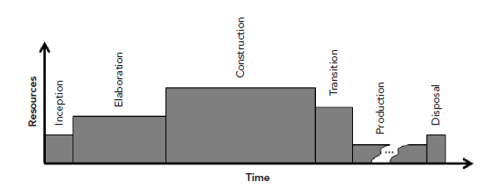
FIGURE 13-5: In the Unified Process, construction takes more time and effort than the other phases

Slide 73
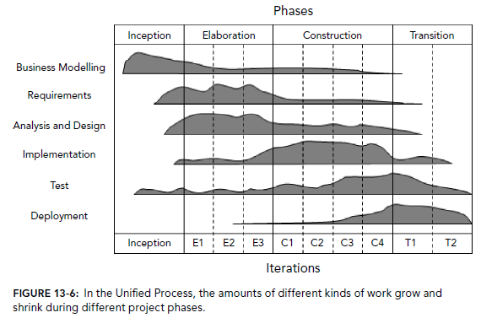

Slide 74
Advantages
The iterative approach enables you to incrementally define the requirements and assemble the application.
The elaboration iterations focus on risks and risk mitigation to improve the project’s chance of success.
The inception and elaboration phases generate a lot of documentation that can help new developers join the team later.
It can enable incremental release if we wanted.

Slide 75
Disadvantages
It’s complicated.
Requires more resources than simpler approaches.
Risk analysis can be difficult.
The complication is not always worth the effort ,especially for low risk projects.
It does’t work well with small projects.

Slide 76
Rational Unified Process(RUP)
Is IBM’s version of the unified process.
Uses the same 4 basic phases as UP
Also uses the same standard engineering disciplines.
Also adds three supporting disciplines: configuration and change management, project management and environment.

Slide 77
Rational Unified Process(RUP)
The main advantages to RUP over UP are the tools provided by IBM that make using the process easier.
Those tools include artificial templates, document production and changing, change request tracking, visual modelling ,performance profiling,etc
Advantages and disadvantages of RUP is same as UP.

Slide 78
Rational Unified Process(RUP)
Variations on UP and RUP
Open Unified Process(Open UP)-is a tool that makes using the unified process easier.
Agile unified process-is another simplified version of RUP.
It brings agile methods to UP.

Slide 79
CLEANROOM
This model emphasizes defect prevention rather than defect removal.
The idea is to build the application in steps that are carefully monitored and tested to prevent anything bad from entering into the application.

Slide 80
Basic principles of cleanroom
Formal methods-
code is produced using formal mathematical methods that help to ensure that the code satisfies the design models.
Code reviews also help to verify that the code correctly implements the required behaviour.

Slide 81
Basic principles of cleanroom
Statistical testing-
Testing uses statistical experiments to estimate the application quality.
Statistical quality control
Code is produced incrementally.
Each increment’s quality is measured to ensure that the project is making acceptable progress.

Slide 82
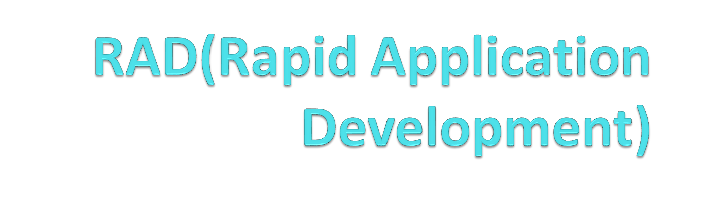

Slide 83
RAD
Incorporates some of the best features of existing models plus new features that help developers to give useful results to the end user quickly.
Techniques used by RAD models push developers to generate as much high quality code as quickly as possible.

Slide 84
RAD Principles
Take iterative ideas to the maximum.
Instead of a year or two, here iterations last a month,a week or less.
Apply iterations not only for programming but also to requirement gathering, requirement validation and design

Slide 85
In BDUF (big design upfront)By the time an application is finished, it doesn’t satisfy the customers’ needs.
Iterative models help keep a project on track, but they have their limits.
If you perform a new iteration every year or so, you could wander far off track before you realize you’re heading in the wrong direction.

Slide 86
Common techniques used in RAD
Small teams that leads to projects of limited scope.
Requirement gathering through focus groups, workshops, facilitated meetings, prototyping and brainstorming.
Requirement validation through iterated prototypes, use cases, and constant customer testing of designs.
Repeated customer testing of designs as they evolve.

Slide 87
Constant integration and testing of new code into the application.
Informal reviews and communication among team members.
Short iterations lasting between a few months and as little as a week

Slide 88
Deferring complicated features for later releases. Doing just enough work to get the job done.
Timeboxing , which is RAD speak for setting a tight delivery schedule for producing something, usually the next iteration of the application. The scope can change but the completion date for the iteration cannot.

Slide 89
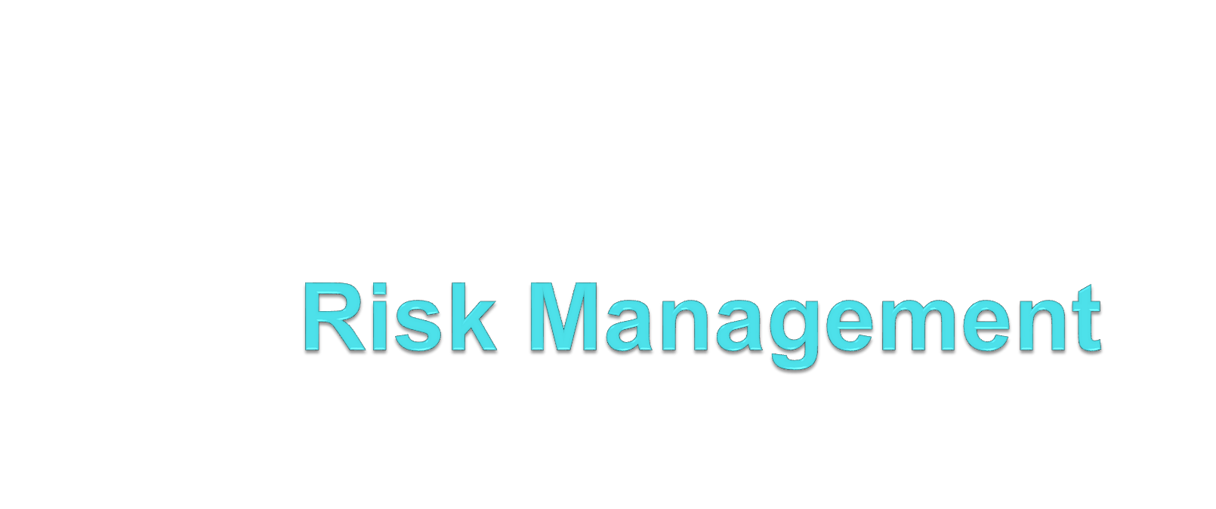

Slide 90
Definition of Risk
A risk is a potential problem – it might happen and it might not
Conceptual definition of risk
Risk concerns future happenings
Risk involves change in mind, opinion, actions, places, etc.
Risk involves choice and the uncertainty that choice entails
Two characteristics of risk
Uncertainty – the risk may or may not happen
Loss – the risk becomes a reality and unwanted consequences or losses occur
90

Slide 91
Risk Categorization – Approach #1
Project risks
They threaten the project plan
If they become real, it is likely that the project schedule will slip and that costs will increase
Technical risks
They threaten the quality and timeliness of the software to be produced
If they become real, implementation may become difficult or impossible
Business risks
They threaten the viability of the software to be built
If they become real, they jeopardize the project or the product
91

Slide 92
Sub-categories of Business risks
Market risk – building an excellent product or system that no one really wants
Strategic risk – building a product that no longer fits into the overall business strategy for the company
Sales risk – building a product that the sales force doesn't understand how to sell
Management risk – losing the support of senior management due to a change in focus or a change in people
Budget risk – losing budgetary or personnel commitment
92

Slide 93
Risk Categorization – Approach #2
Known risks
Those risks that can be uncovered after careful evaluation of the project plan, the business and technical environment in which the project is being developed, and other reliable information sources (e.g., unrealistic delivery date)
Predictable risks
Those risks that are extrapolated from past project experience (e.g., past turnover)
Unpredictable risks
Those risks that can and do occur, but are extremely difficult to identify in advance
93
Notes:
Extrapolated - concluded

Slide 94
Reactive vs. Proactive Risk Strategies
Reactive risk strategies
"Don't worry, I'll think of something"
The majority of software teams and managers rely on this approach
Nothing is done about risks until something goes wrong
The team then flies into action in an attempt to correct the problem rapidly (fire fighting)
Proactive risk strategies
Steps for risk management are followed
Primary objective is to avoid risk and to have a contingency plan in place to handle unavoidable risks in a controlled and effective manner
94

Slide 95
For each task, you should determine:
➤ Likelihood —Do you know more or less how to perform this task? Or is this something you’ve never done before so it might hold unknown problems?
➤ Severity —Can the users live without this feature if the task proves difficult? Can you cancel this feature or push it into a future release?
➤ Consequences —Will problems with this task affect other tasks? If this task fails, will that cause other tasks to fail or make other tasks unnecessary?
95

Slide 96
Work-arounds —Are there work-arounds? What other approaches could you take to solve this problem? For each work-around consider:
➤ Difficulty —How hard will it be to implement this work-around? How long will it take? What are the chances that this work-around will work?
➤ Impact —What affects do the work-arounds have on the project’s usability? Is this going to make a lot of extra work for the users?
➤ Pros —What are the work-arounds’ advantages?
➤ Cons —What are the work-arounds’ disadvantages?
96

